Slide 1
- A Snapshot
1.2.6
Start

Slide 2
Table of Contents
Introduction
Why do you need RMS
1
Task Codes
14
MLC 2006 Standard A2.3
2
Crew Management
15
How is Inzentio-RMS different?
3
Holidays
16
Salient Features – Inzentio RMS
4
IDL
17
Rest Hours Log
7
Ranks
18
NC Summary
12
Regimes
19
Vessel Schedule
13
Reports
20

Slide 3
Introduction
Inzentio RMS, is a ‘Rest Management Tool’ for recording ‘Rest/ Work’ hours of the staff on board a ship and for checking ‘non-conformities,’ based on various regulations at the click of a button, automatically.
This presentation includes snapshots of the key aspects of this tool, giving the reader a complete understanding of what this software is all about.
Note : Using the navigation keys to guide yourself through the presentation.

Slide 4
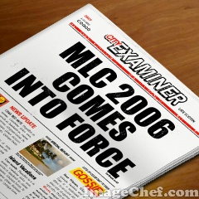
1
Why do you need RMS?
MLC 2006 : This convention has come into effect on 20th August 2013 and is applicable to all vessels trading in high seas above 200GT, depending on the flag of the vessel.
As per MLC 2006 convention,
A shipboard working arrangement schedule for all staffs should be posted in an accessible place(s).
Accurate record of hours of work and rest should be recorded for all staff on board. These records should be as per the ILO format, duly signed by the Master (or a person authorised by the Master) and the seafarer whose record it is. These records should be available at all times for audit by various organisations that are concerned with implementation of MLC 2006.
According to MLC 2006, the shipboard working arrangement should be based on 8 hours per day with a minimum one day of rest per week and rest on public holidays.
The liability of providing adequate rest to all staff on board, monitoring and taking corrective action if non-conformity occurs frequently, lies with the operator of vessel.

Slide 5
2
MLC 2006 Standard A2.3
As per MLC 2006 convention, Standard A2.3 para12,
“Each Member shall require that records of seafarers’ daily hours of work or of their daily hours of rest be maintained to allow monitoring of compliance with paragraphs 5 to 11 inclusive of this Standard.
The records shall be in a standardized format established by the competent authority taking into account any available guidelines of the International Labour Organization or shall be in any standard format prepared by the Organization.
They shall be in the languages required by paragraph 11 of this Standard. The seafarers shall receive a copy of the records pertaining to them which shall be endorsed by the master, or a person authorized by the master, and by the seafarers.”

Slide 6
3
How is Inzentio-RMS different?
Inzentio RMS provides a system to record rest / work hours for all staff on board.
It has been developed on an intranet web platform which is accessible to all authorized crew in the same network.
Its design is easy to use and doesn't need any extra training for user to understand and use. It is created with the consultation of end user ( seafarer).
It has the option of uploading templates ( the work schedule) hence minimising time required by he user to update his rest hours.
It gives the option to the operator, as per his flag state’s acceptance, to use STCW 2010 exemption along with MLC 2006. Exemptions can be turn on/ off as required by the operator.
Inzentio-RMS has built-in OPA 90 (as per 46 U.S.C. 8104) (work/ rest hours) and can be turned on for a specific period, as required by the master, during its trade in US waters.
Its fundamentals and computations are based on the “OCIMF RECOMMENDATION” hence its results are accepted by all organizations.

Slide 7
4
Salient Features - Inzentio RMS
All “Menu buttons” are available in each page hence available for the user to toggle between pages at ease at any given time.
Recording of details of all staff onboard includes, Employee No., Seaman Book No., Nationality, Sign-on/ Sign-off dates, if he is a watch-keeper and if he is entitled for extra overtime.
A staff can record his work/rest hours with the type of duties performed. This option to record the type of duties performed simultaneously along with rest/work hours, eliminates extra time required to tag work hours with type of duties performed.
The ‘Rest Hours Log’ displays records for a complete month at any given instance, along with the last seven days of the previous month so as to provide the user better visibility to check his non-conformities.
Check boxes are provided against each date in the ‘Rest Hours Log’ page, so that the user can select the exact dates he wants to edit and thus avoid errors in updating.
A header of ‘Hours-Scale’ is repeated at specific intervals for the user’s convenience of viewing the log against the time period as he scrolls up/down the page.

Slide 8
Back

Slide 9
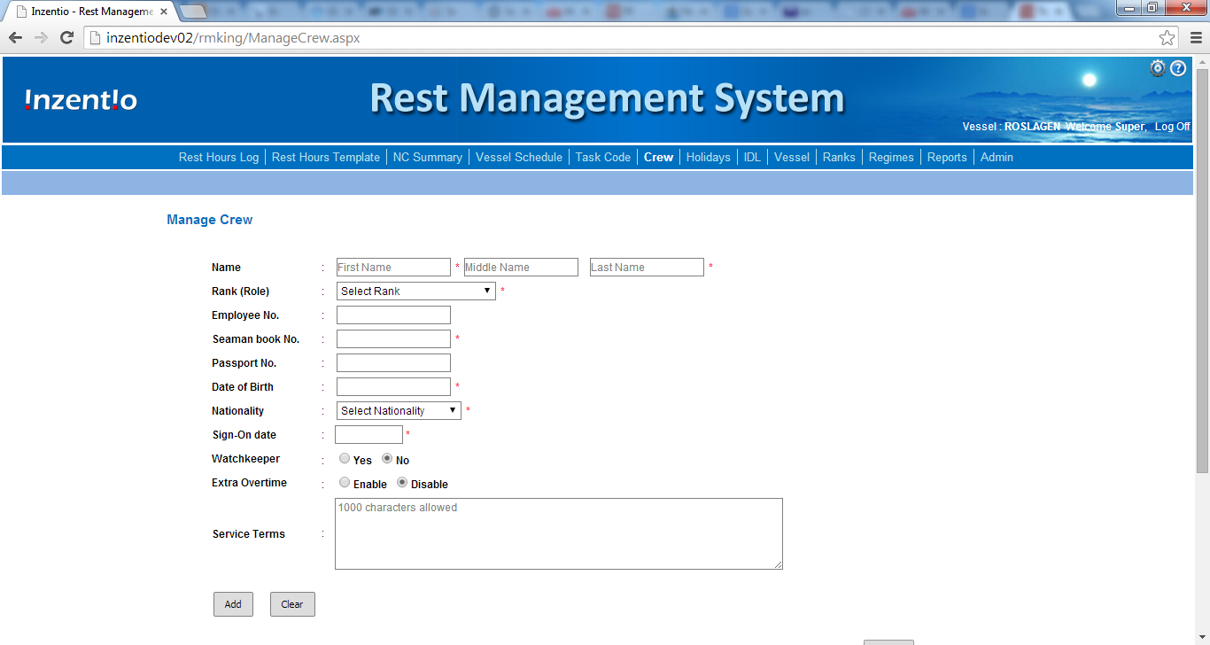
Back

Slide 10
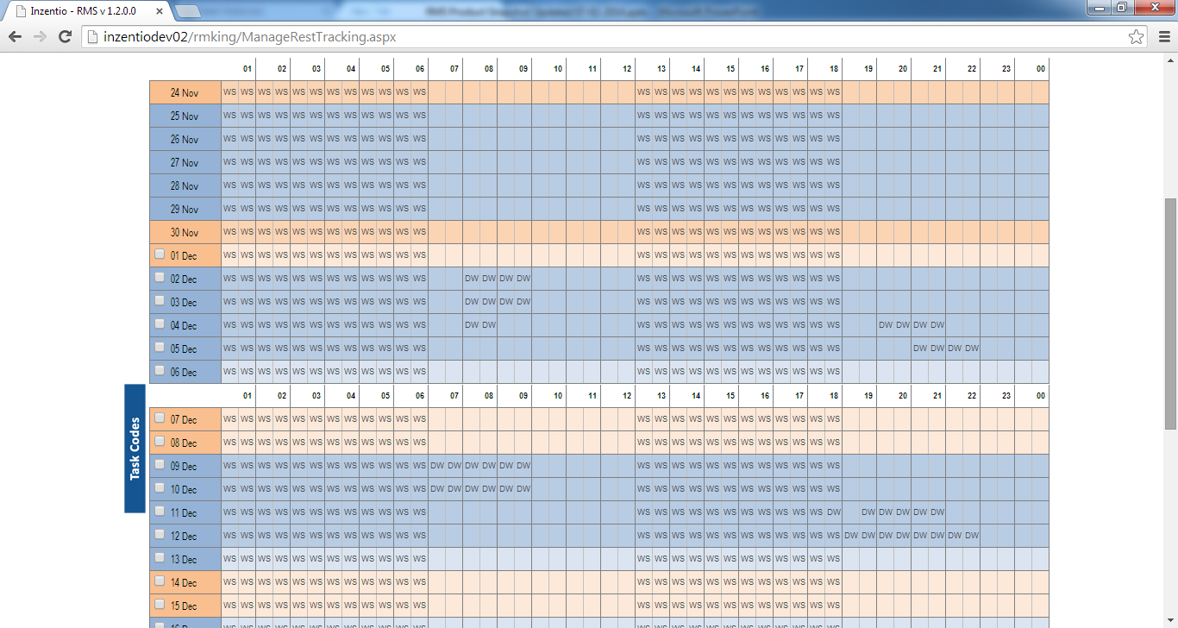
Back

Slide 11
Back

Slide 12
✓
Back

Slide 13
Back

Slide 14
5
Salient Features - Inzentio RMS (contd..)
Weekends are coloured differently for easy reference for the user.
User can edit the task-codes based on the type of work; task-codes are TWO-lettered codes that have a defined type of duties assigned.
To update the grid in the ‘Rest Hours Log,’ with the same activity, the user just has to select the appropriate task-code, click and drag through the desired cells.
A double-click on a filled-in cell would clear the cell and depict as rest hours.
If any staff fails to update his ‘Rest Hours’ for a consecutive seven days, an option is available for an alert to be generated and sent to authorised person (Vessel manger) and master.
The various legends (markings/ colour codes) used in the ‘Rest Hours Log’ are available for reference on a click of a button on all pages for user’s guide.
‘Rest Hours Log’ displays the regimes that are currently active and keeps the user up-to-date.

Slide 15
Back

Slide 16
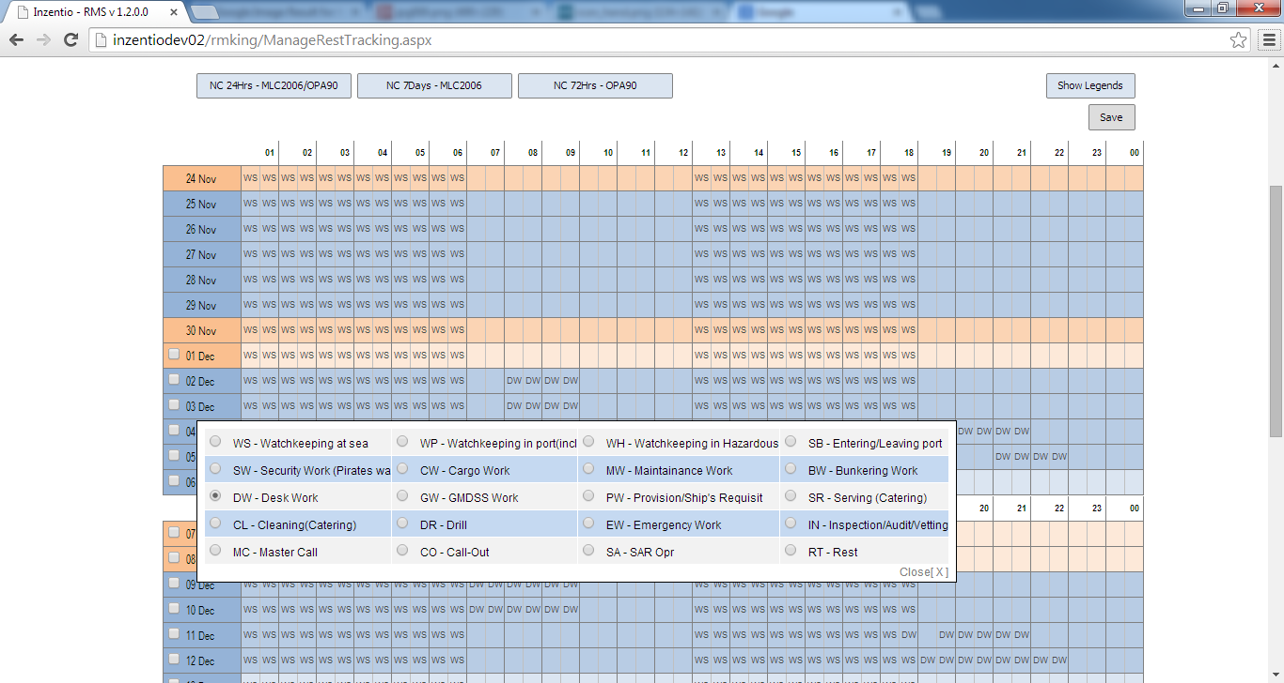
Back

Slide 17
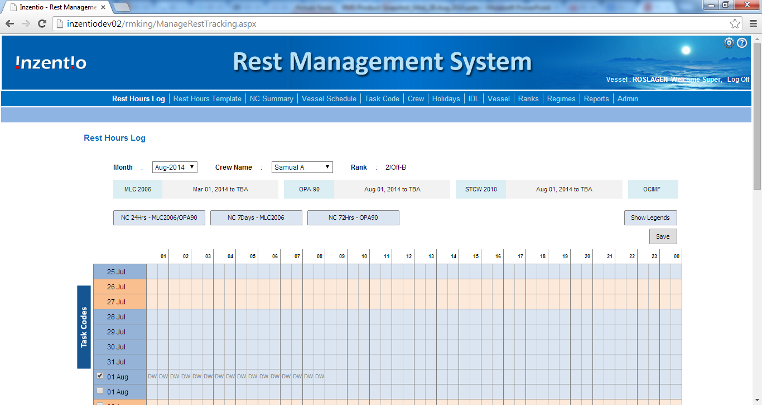
Back

Slide 18
6
Salient Features – Inzentio RMS (contd..)
The ‘Rest Hours Log’ has the option to check for ‘Non-conformities’ based on 24-hrs and 7-days as per MLC 2006 and 72-hrs as per OPA 90.
Once the user edits his rest log and clicks on ‘Save,’ the system automatically checks for any ‘non-conformities’ and alerts the user. The user can thus plan his future activities so that ‘non-conformities’ can be avoided.
Each user can create ‘Templates’ of work/ rest hours based on their scheduled work such as weekdays/ weekends and Port and Sea. When the templates are assigned to a particular period, the ‘Work/ Rest’ gets populated automatically based on ‘Weekdays/ Weekends’ and also on location (Port/ Sea), as updated by the PIC in the ‘Vessel Schedule’ page.
Templates created by one user can be imported by another user thus eliminating unnecessary time for duplication of work.
Multiple templates become so handy when shifts are rotated every other month.

Slide 19
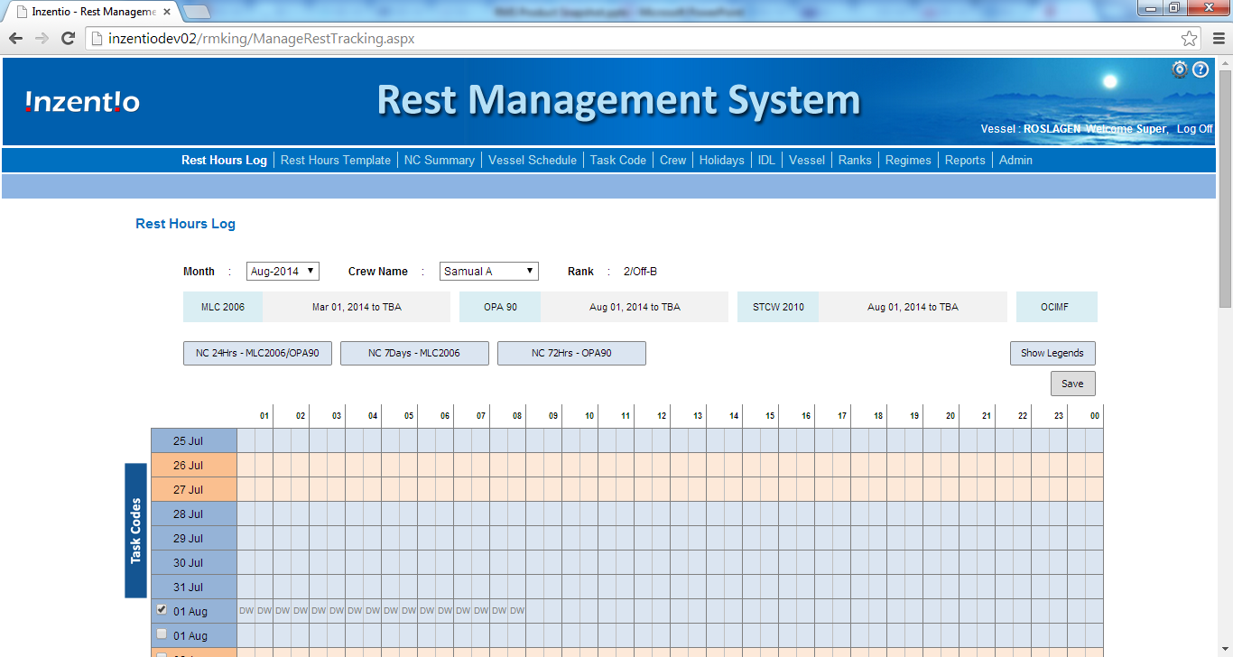
7
Rest Hours Log
This page is used to plan and record the rest hours either by the crew or his Manager for compliance verification. This page gives an overall view of all non-conformity for a month for the Master / Manager to take necessary steps such as investigation on root cause and action needed to avoid such NC in future.

Slide 20
Back

Slide 21
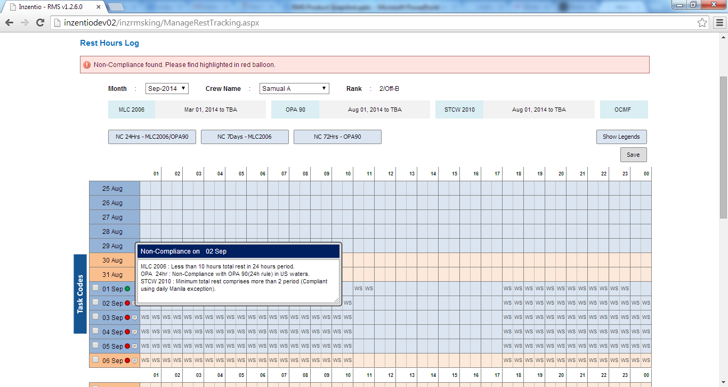
8
Rest Hours Log
Non-Conformity Indication
When a user has non conformities,
A red balloon against the date indicates non-conformity
A green balloon against the date indicates non-conformity but with STCW2010 Manila exemption.

Slide 22
Back

Slide 23
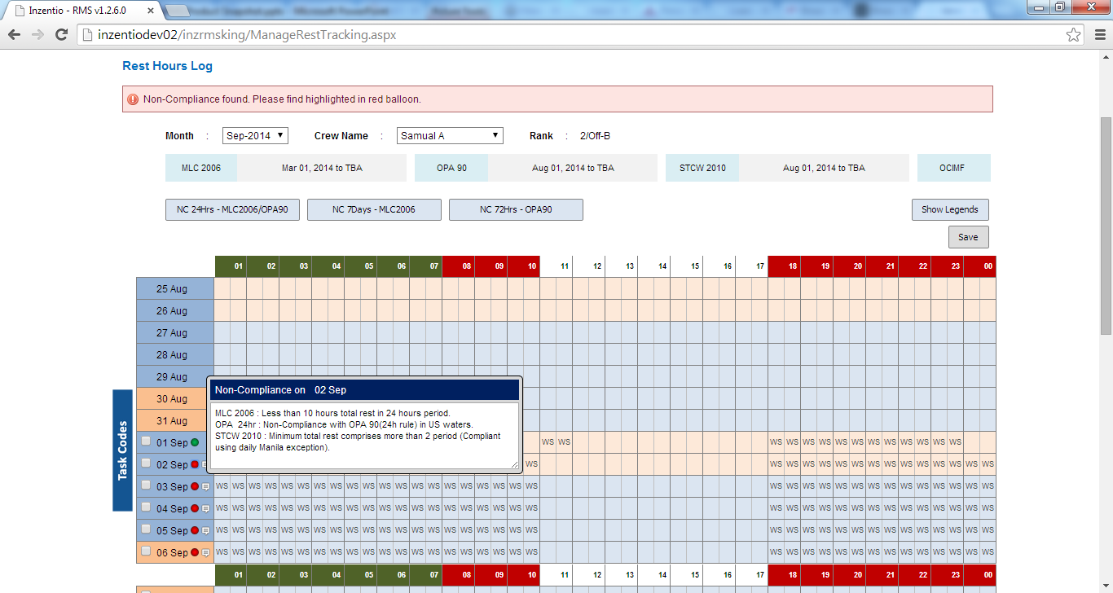
9
Rest Hours Log
The user can click on the balloon (Red/ Green) and find out the period (highlighted in Red) in which the non-conformity has occurred.
The user can check and mark the work hours accordingly in this period to avoid non-conformity. This is very useful to predict future non-conformities, when used in tandem with ‘Rest Templates.’

Slide 24
Back

Slide 25
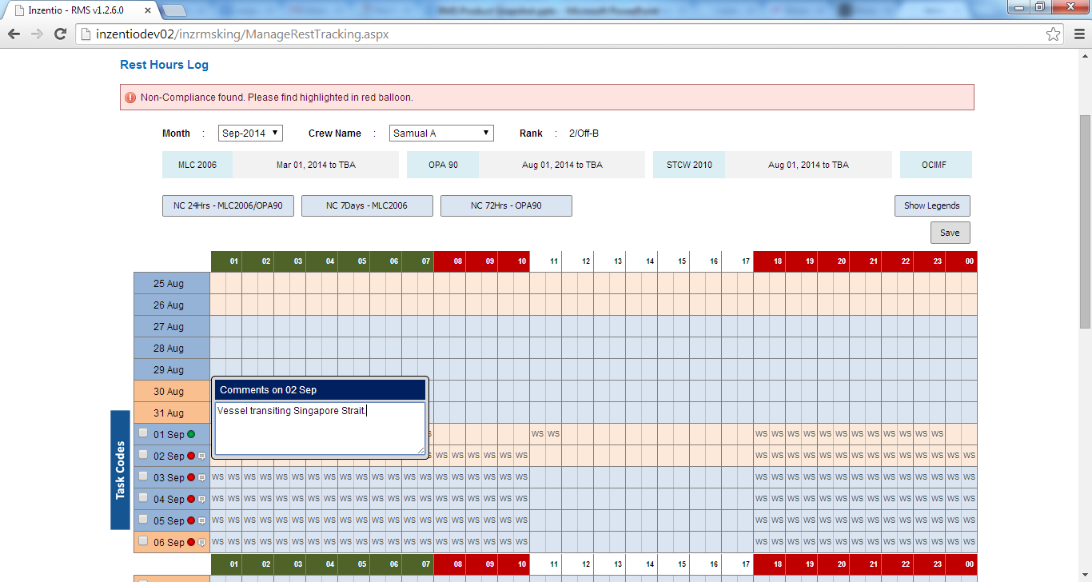
10
Rest Hours Log
The user can click on the comments icon next to the balloon (Red/ Green) and add comments to the comments box, as to why a non-conformity had occurred.
These comments would be listed in the ‘Non-conformities’ page in the staff ‘Rest/ Work’ report.

Slide 26
Back

Slide 27
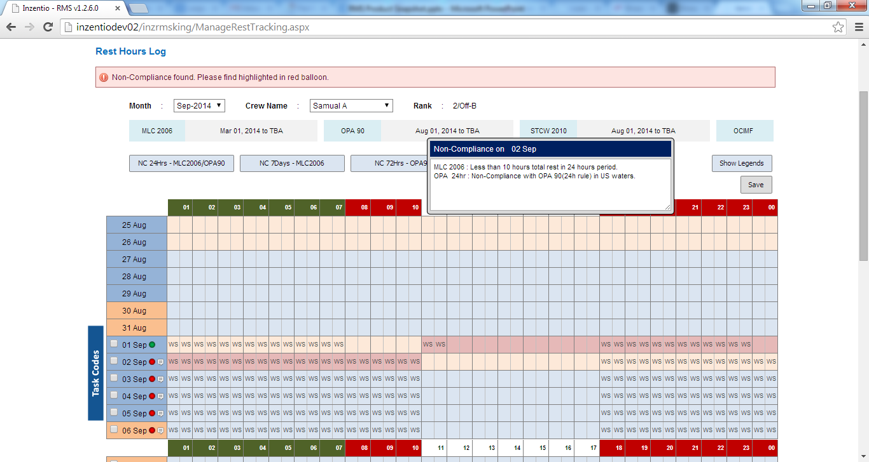
11
Rest Hours Log
When the user clicks on the non-conformity period highlighted in ‘Red,’ the regime/ regulations under which the non-conformity has occurred, will be displayed.

Slide 28
Back

Slide 29
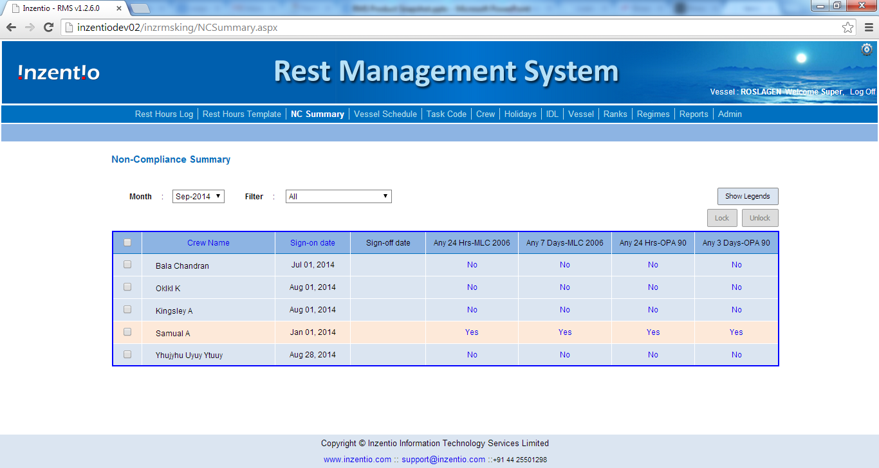
12
Non-Conformities (NC) Summary
The ‘Non-Conformities Summary’ page which is the home page for the Master/ Manager, gives the Master/ Manager, a snapshot view of all non-conformities that have occurred in the past, to help him initiate an investigation on ‘root cause,’ and/ or plan actions to avoid such NCs in the future.

Slide 30
Back

Slide 31
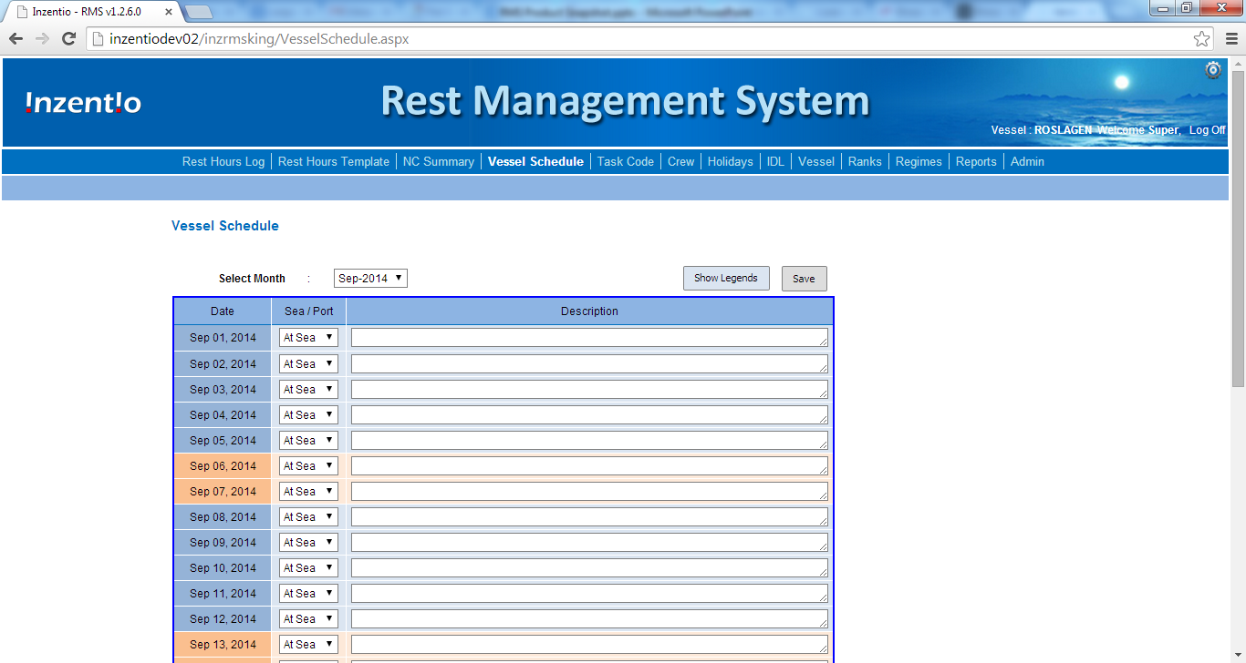
13
Vessel Schedule
The ‘Vessel Schedule’ is updated by the PIC of RMS based on the location of the Ship on a particular day along with a short description as required. This is reflected in the ‘Rest Hours Log,’ thus enabling the users to record their ‘Work/ Rest’ hours with ease.

Slide 32
Back

Slide 33
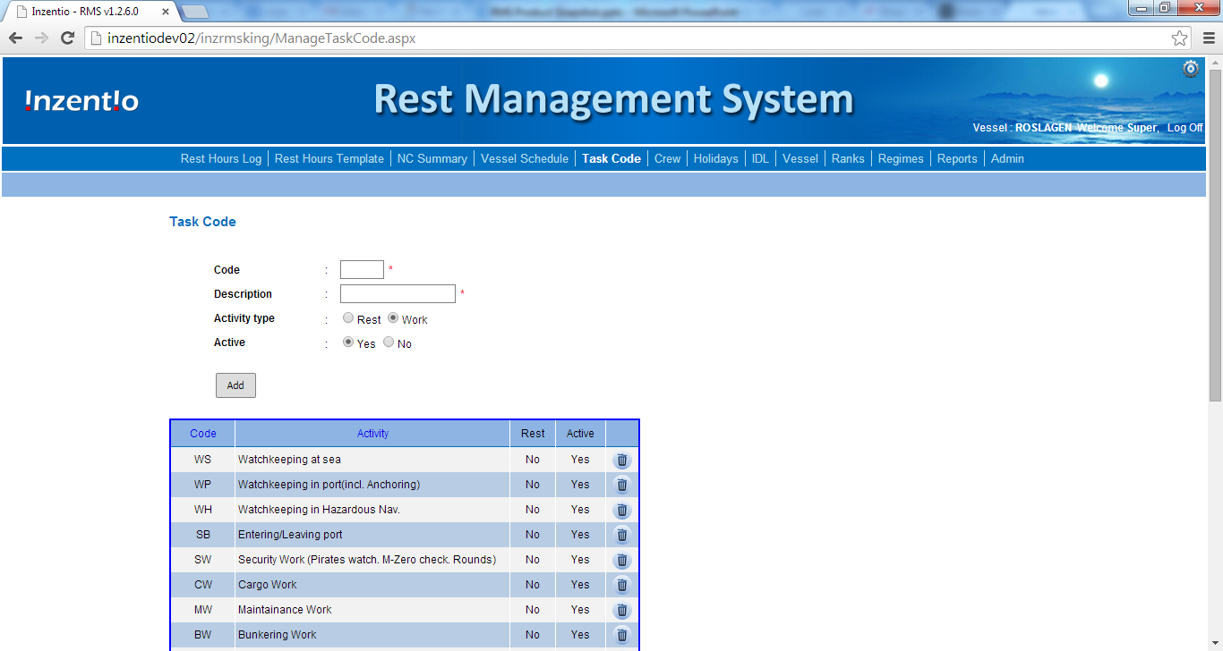
14
Task Codes
The ‘Task-codes’ module helps the Master/ the PIC to add, remove or edit task-codes. A pre-defined list of tasks are included in the software and the user can amend this list based on the various duties performed on that particular vessel.

Slide 34
Back

Slide 35
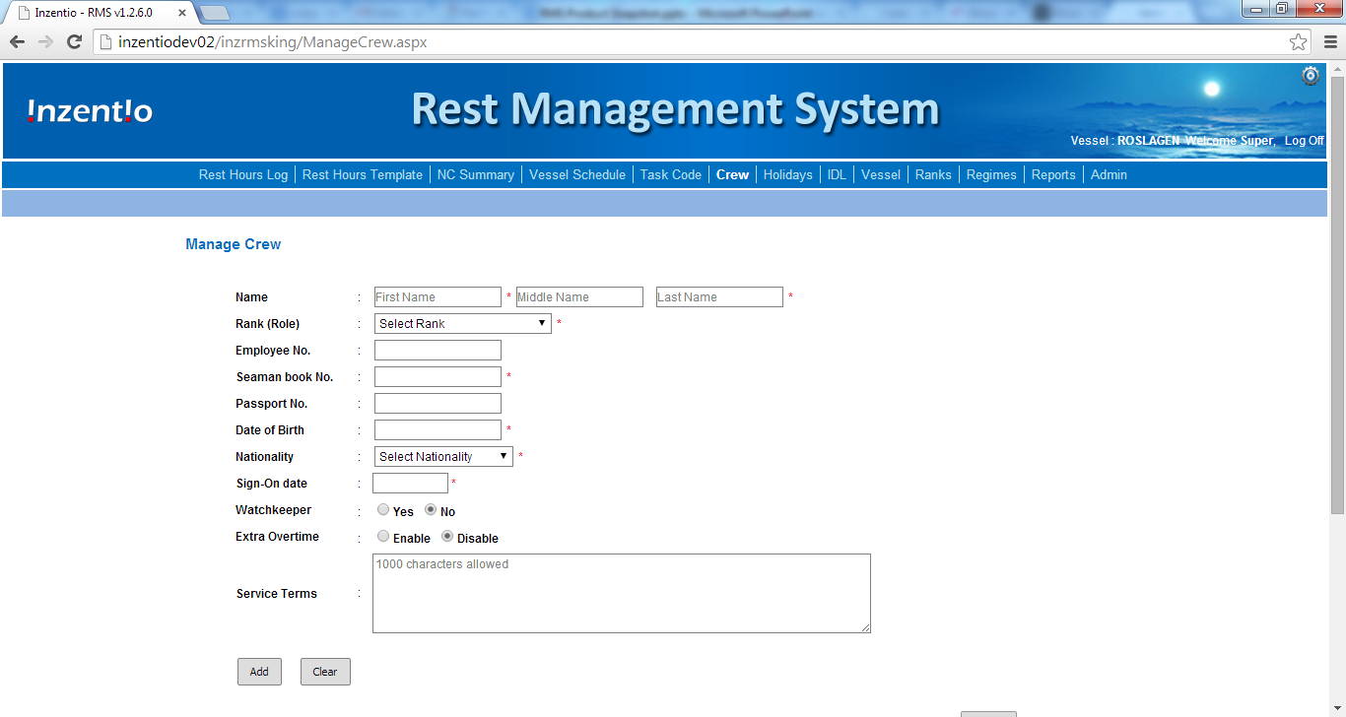
15
Crew Management
The Master/ the PIC can Add or Update Crew to the RMS through this ‘Manage Crew’ page.

Slide 36
Back

Slide 37
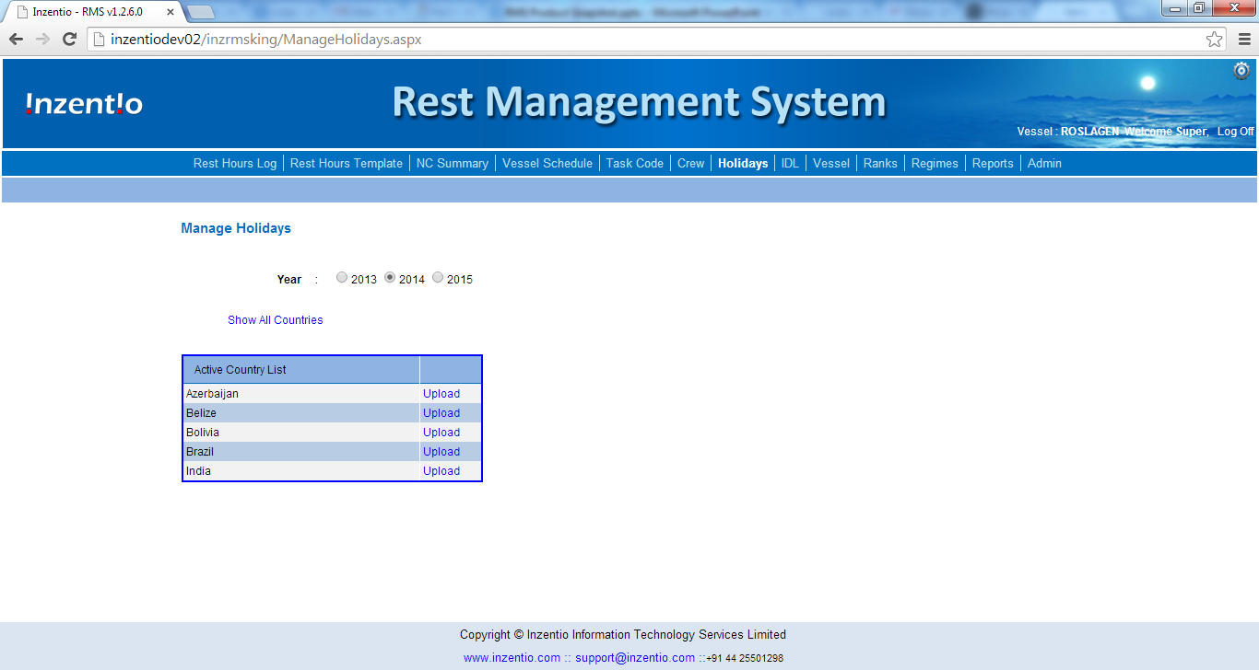
16
Holidays
The Master/ the PIC should upload the holiday database, based on the nationalities of the staff every year.
Uploading of national holidays would help in matching the overtime given to staff and the rest hours, during audits.

Slide 38
Back

Slide 39
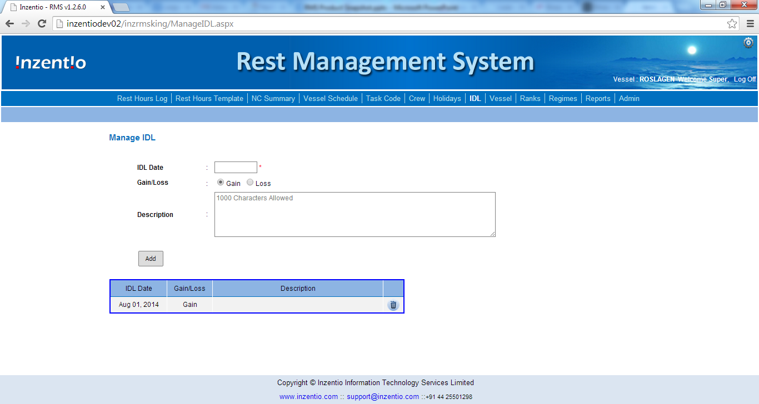
17
International Date Line
The Master/ the PIC would update the dates, accordingly, whenever the vessel crosses either side of the ‘International Date Line.’
The system would add/ remove dates based on the IDLs recorded here from the ‘Rest Hours Log.’

Slide 40
Back

Slide 41
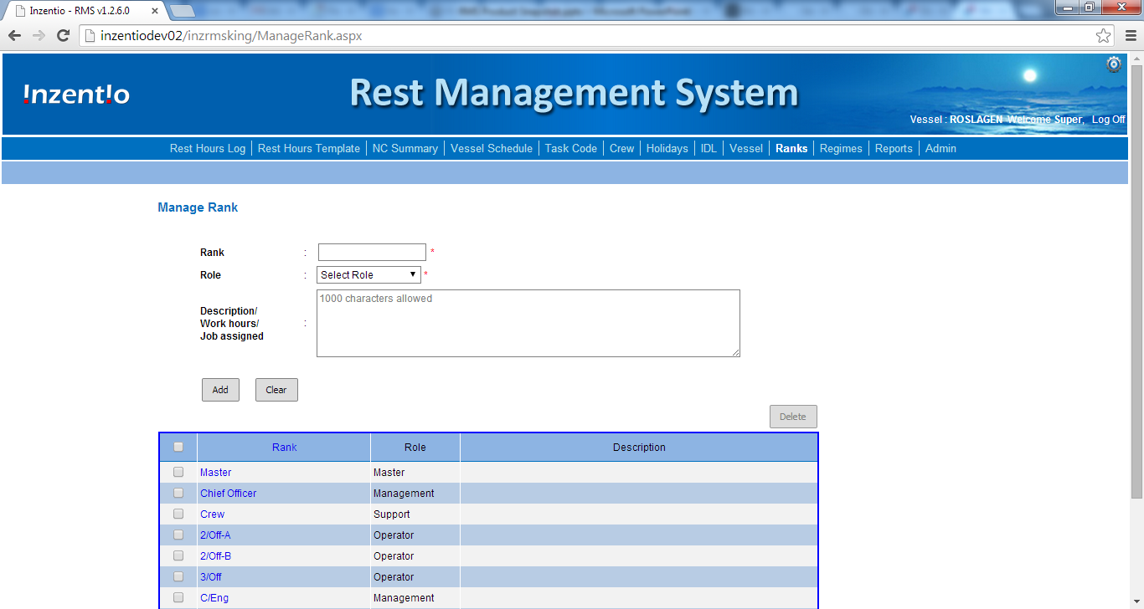
18
Ranks
The Master/ the PIC can assign the roles for each rank in the vessel. The various responsibilities for each role can also be edited here, thereby, helping the admin to have the right staff to handle the RMS application and avoid any undesired changes by un-authorised users.

Slide 42
Back

Slide 43
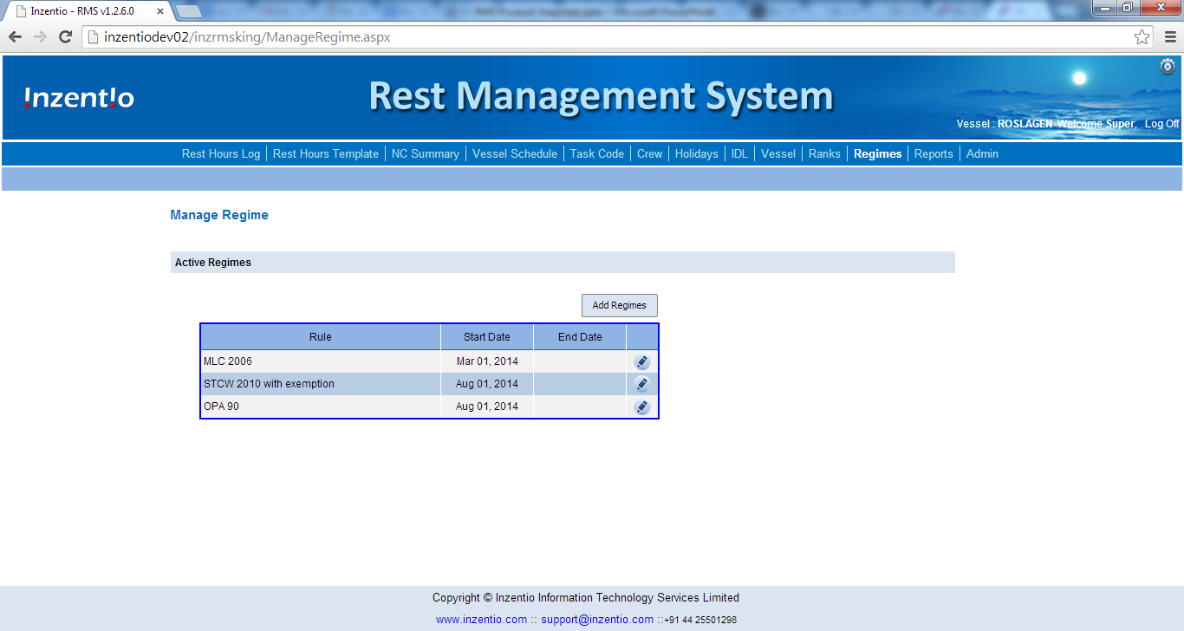
19
Regimes
The Master/ the PIC can Add, or update various regimes and their period for which the rest hours of crew should in compliant with. Any applicable regime(s) can be turned on/ off through the ‘Admin’ module during the initial phase of the software setup.

Slide 44
Back

Slide 45
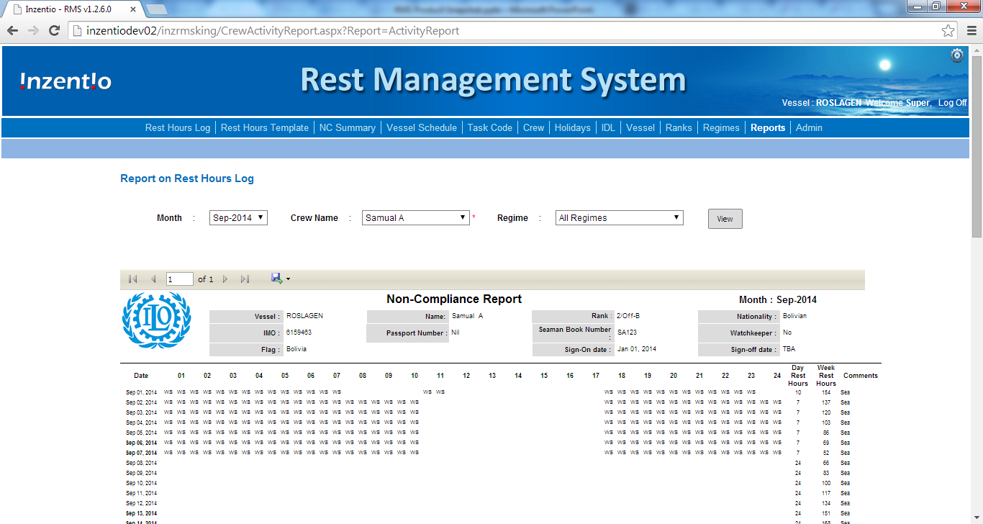
20
Reports
Reports are in the recommended format as per ILO, for acceptance by all countries.
Reports for one or all staffs can be generated for every month of their tenure on the vessel.

Slide 46
Back

Slide 47
The End
Press ‘Esc’ to quit.
Quit

